Slide 1
Take Home Challenge
Paolo Natividad

Slide 2
Calculate the mean ticket amounts for men and women
The mean for Females is $76.93
The mean for Males is $52.68

Slide 3
Test and explain whether any difference you observe between men's and women's ticket amounts is large
Using a 2 sample 2 test one can determine if there is a difference between the two groups.
Performing a T test returned a pvalue of 5.7 E13 which is well below the value of significance

Slide 4
Do some officers tend to give larger tickets?
Performing ANOVA on all the officers showed that there is not a significant difference between all the officers.

Slide 5
Do some Wards tend to have larger tickets?
Performing ANOVA on the wards shows that there is not a significant difference between the wards in ticket size.

Slide 6
Modeling
One Vs Rest (Gradient Boosting Classifier)
Baseline = 38.6%
Test Score = 46.5%

Slide 7
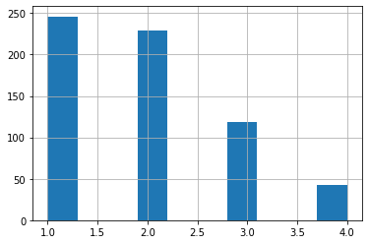
Hist of statuses

Slide 8
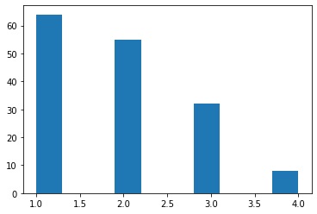
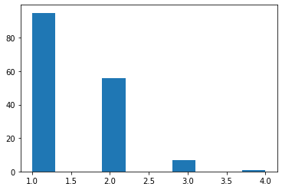
Hist of Actual
Hist of Preds
Notes:
Predicted more challenged did not predict enough overdues

